Slide 1

Getting started with NodeBots!
Mark West

Slide 2
Background

Slide 3
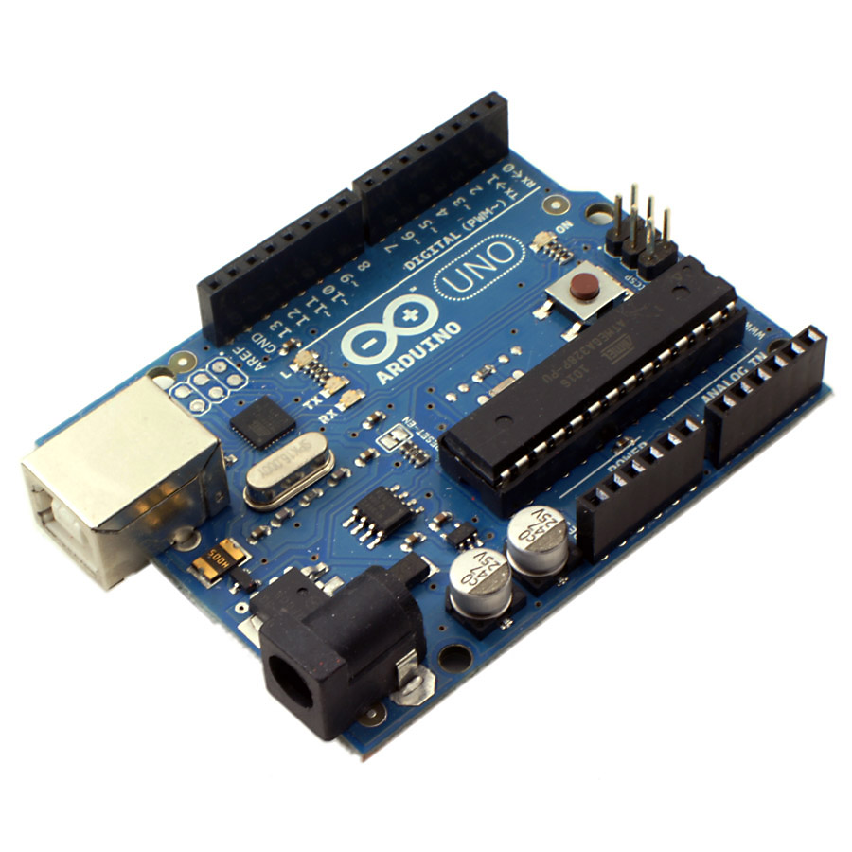




Slide 4
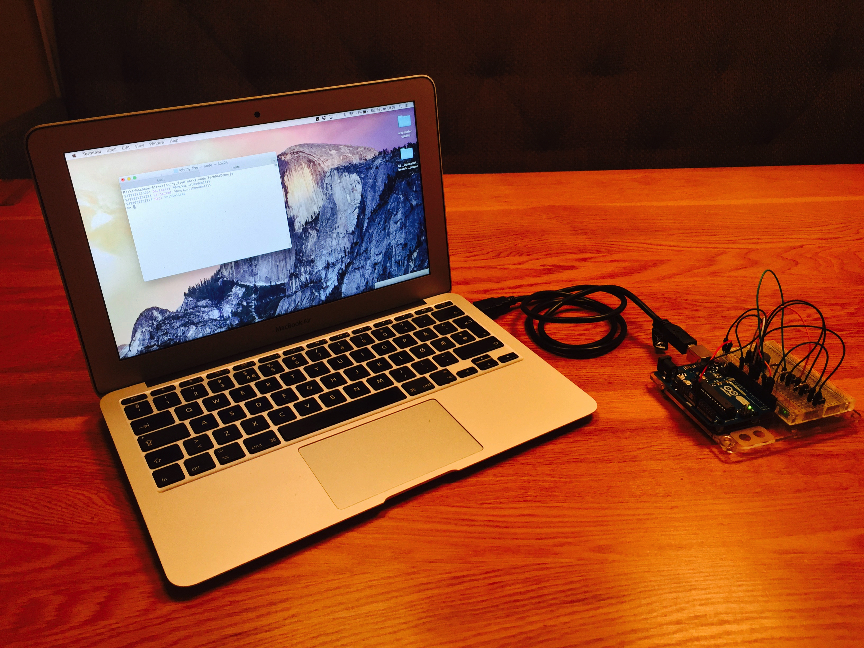
Laptop running Johnny-Five
Serial Cable
Allowing Johnny-Five to talk to Firmata
Arduino Uno running Firmata
Notes:
Note that JavaScript doesn’t run directly on the UNO. So how does Johnny-Five actually work?
Well bascially we start by installing the Firmata Protocol on the Arduino UNO. This provides an API for controlling the board. The Johnny-Five process runs on your laptop and sends commands to the Arduino via the Firmata Protocol. This requires a serial connection, which can be a cable, bluetooth or wireless.

Slide 5
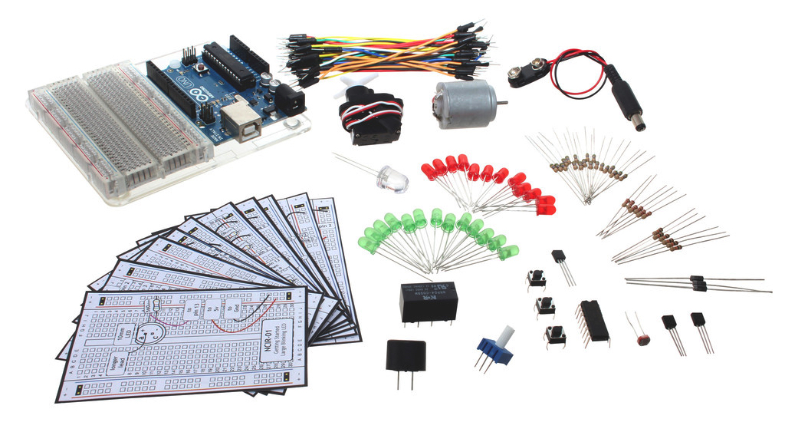
Notes:
So my next step was to buy some equipment – I picked up an Arduino experimenters kit for about 700kr – and now I will show you my first program.

Slide 6
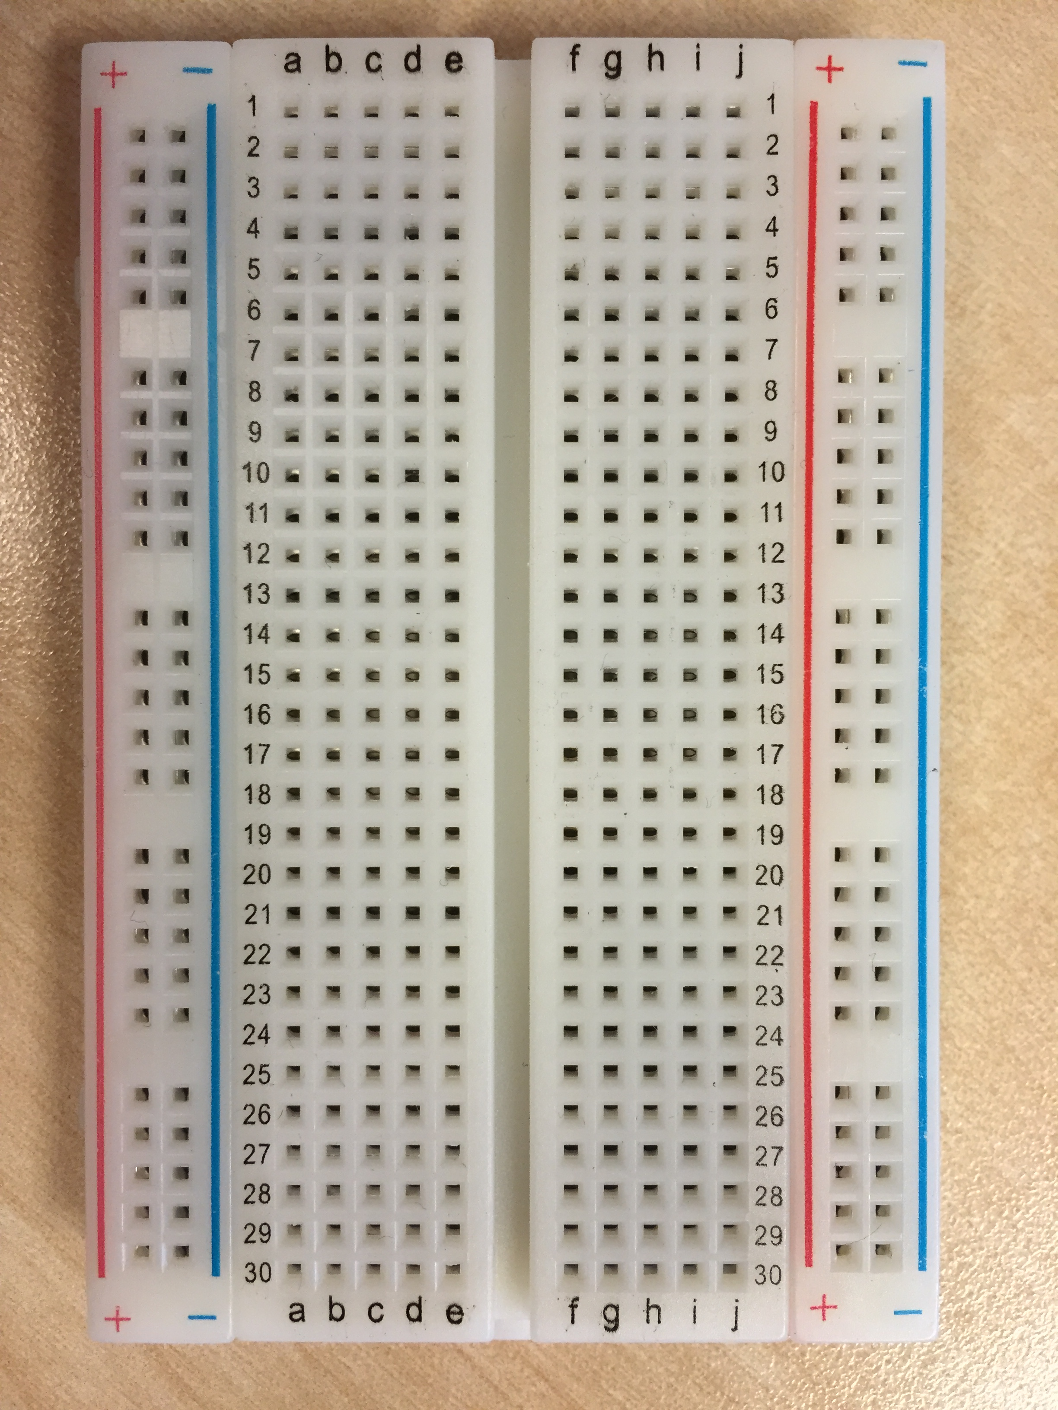
X
X
X
X
X
X
X

Slide 7
Exercises

Slide 8
https://github.com/markwest1972/johnny_five_intro

Slide 9
Exercise One
Installation & Setup

Slide 10
Exercise Two
Simple LED Blink

Slide 11
var five = require("johnny-five");
var myBoard, myLed;
myBoard = new five.Board();
myBoard.on("ready", function() {
myLed = new five.Led(13);
myLed.blink(500);
});
Notes:
Require statement
On ready event
Led object, initialised with pin 13 (location of the build in Led)
Led method

Slide 12
Exercise Three
Controlling LED with Button

Slide 13
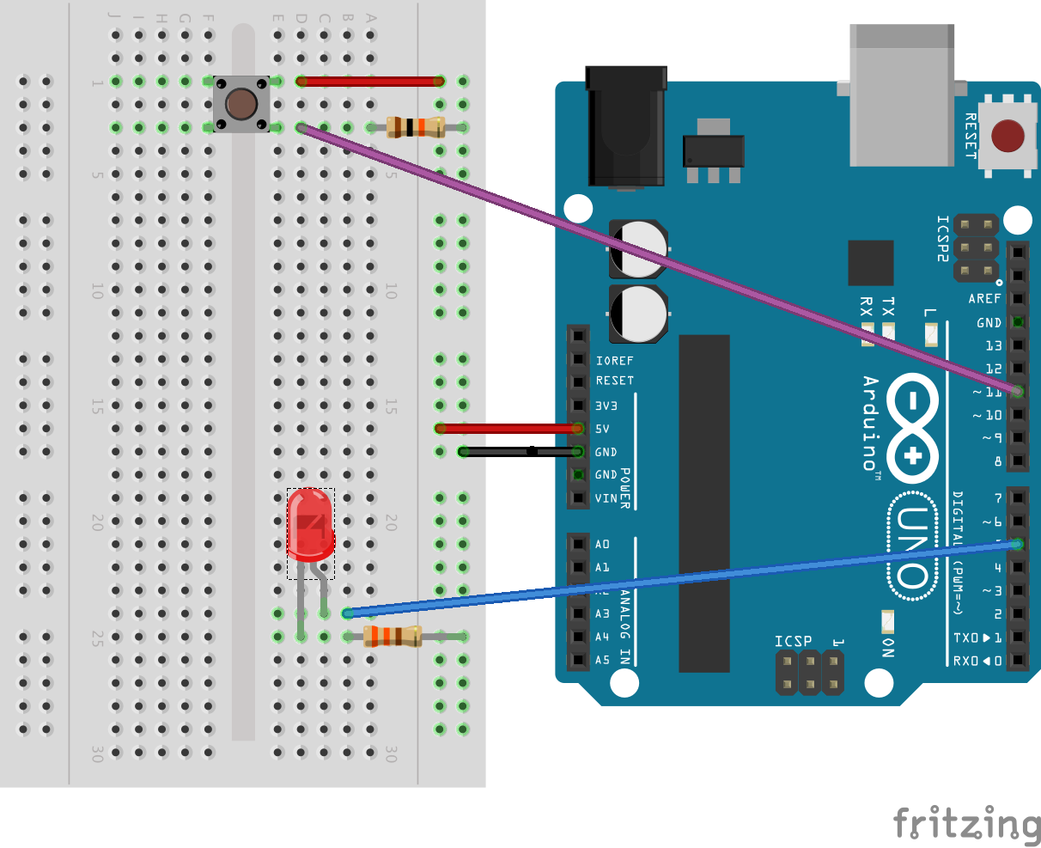
Notes:
Resistors
The 330 ohm resistor prevents the LED from being burnt out.
The 10k ohm resistor is included because an Arduino doesn't sense the same way we do (ie button pressed, button unpressed). Instead it looks at the voltage on the pin and decides whether it is HIGH or LOW. The button is set up to pull the Arduino's pin LOW when it is pressed, however, when the button is unpressed the voltage of the pin will float (causing occasional errors). To get the Arduino to reliably read the pin as HIGH when the button is unpressed, we add the pull up resistor.
Led
Make sure it’s the right way around.

Slide 14
var five = require("johnny-five");
var myBoard, myLed, myButton;
myBoard = new five.Board();
myBoard.on("ready", function() {
myLed = new five.Led(5);
myButton = new five.Button(11)
myButton.on("up", function(value){
myLed.fadeOut();
});
myButton.on("down", function(value){
myLed.fadeIn();
});
this.repl.inject({
replLed: myLed
});
});
Notes:
Now adding the Button object and connected it to Pin 11.
Led is connected to pin 5.
On up and down events the Led is faded on and off.
Note the REPL object.

Slide 15
Exercise Four
Controlling LED & Servo with Pentiomenter

Slide 16
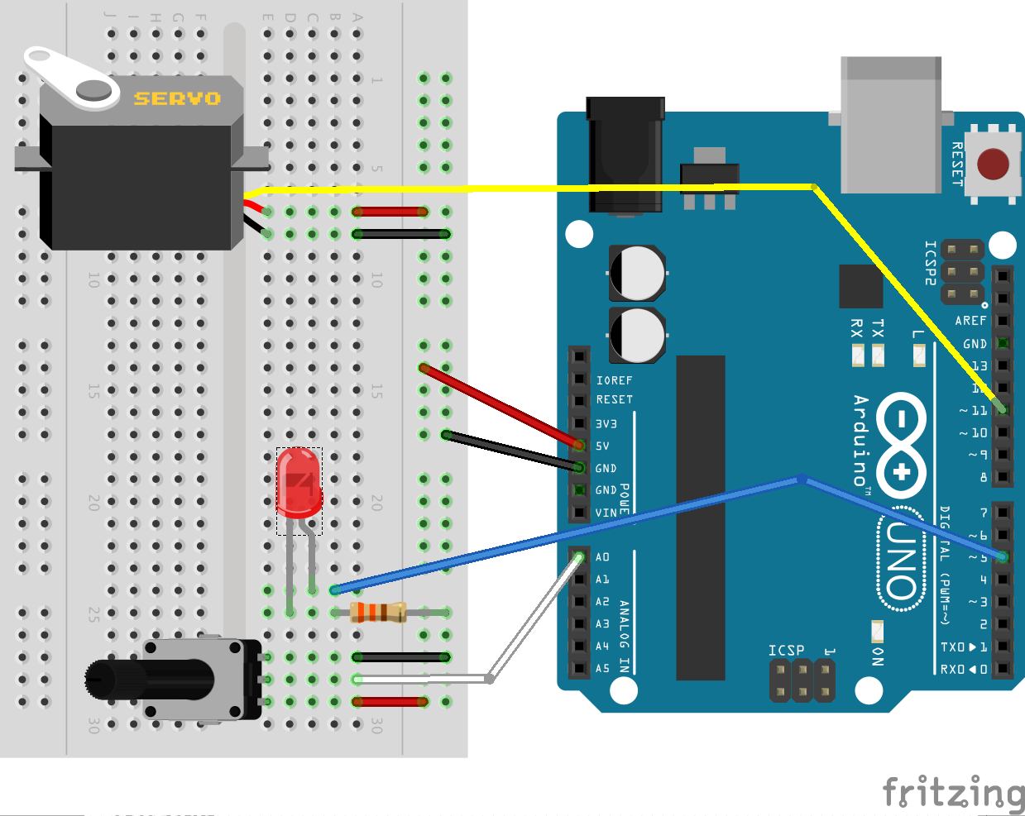
Notes:
Led setup is unchanged.
Pentiometer
Added Pentiometer – note three pins – positive, negative and PWM.
Servo
Added Servo – note three pins – positive, negative and Analog.

Slide 17
Arduino Pin Types
Analog Pins let you read/write analog values with 10 bits of resolution (i.e. 1024 different values).
Digital Pins allow read/write of boolean values, basically off or on.
Digital PWM Pins provide 8 bits of resolution (i.e. 256 different values). This is done by switching the Pin on and off at different speeds.

Slide 18
var five = require("johnny-five");
var myBoard, myServo, myPotentiometer;
myBoard = new five.Board();
myBoard.on("ready", function() {
myServo = new five.Servo(11);
myLed = new five.Led(5);
myPotentiometer = new five.Sensor({
pin: "A0",
freq: 250
});
myPotentiometer.scale(0, 180).on("data", function() {
myLed.brightness(Math.floor(this.raw / 4));
myServo.to(this.scaled);
});
myBoard.repl.inject({
replServo: myServo,
replLed: myLed
});
});
Notes:
Instantiated the Servo Object (connected to the Digital PWM Pin 11 on the Arduino UNO). The 256 different output values supported by the PWM Pin tell the Servo to move to a variety of positions.
Instantiated the LED Object (connected to the Digital PWM Pin 5 on the Arduino UNO). The 256 different values supported by the PWM Pin will make LED light up with different intensities.
Instantiated a Sensor Object to represent the Potentiomenter (connected to the Analog Pin "A0" on the Arduino UNO). This allows for a range of inputs from 0 to 1024, depending on the position of the Potentiomenter.
Note that the 'freq' parameter refers to how often the Sensor will be read.
On events from the Potentiometer:
..the LED was brightened or dimmed accordingly.
..the 10 bit input value (provided by the Potentiometer) was mapped to the range of movement supported by the Servo (180 degrees) and the Servo was moved to reflect this.

Slide 19
Exercise Five
Controlling LED & Servo with Keyboard

Slide 20
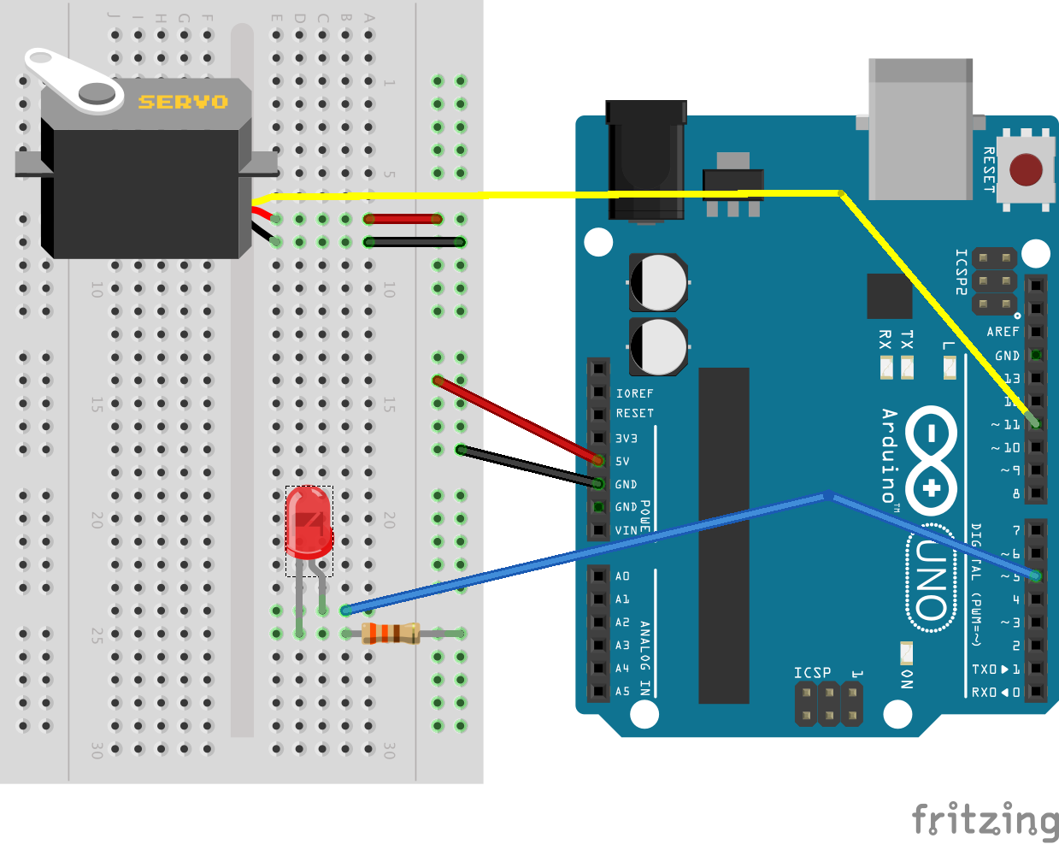
Notes:
Same setup as before – just removed Pentiometer!

Slide 21
Notes:
Heres where the node ecosystem comes in handy! We can use the node package module to download…..

Slide 22
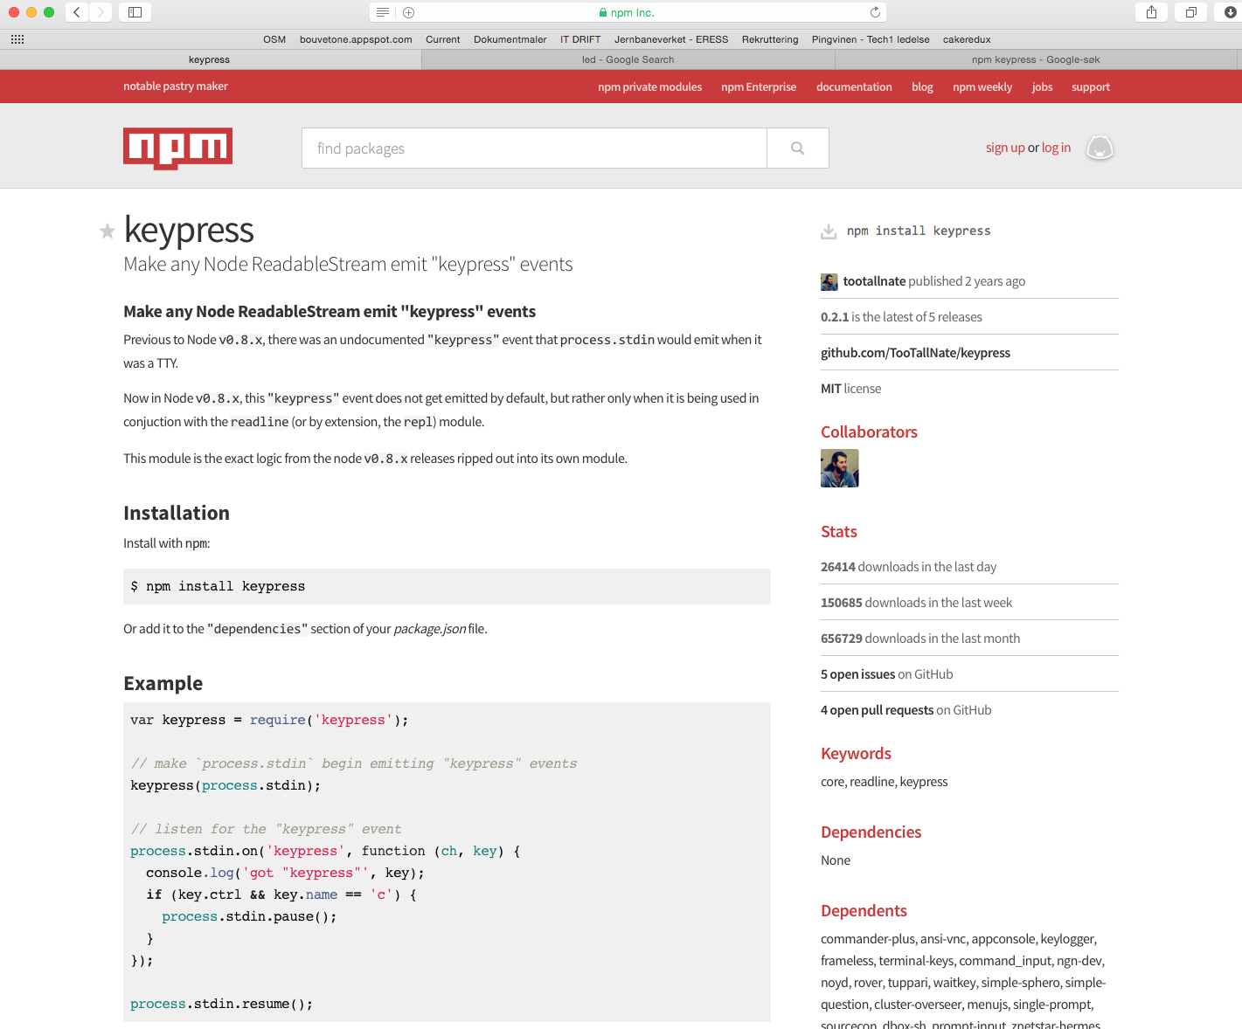
Notes:
Keypress allows you to emit events for keyspressed in the REPL.

Slide 23
var five = require("johnny-five");
var keypress = require("keypress");
var myBoard, myServo;
var brightness = 0;
keypress(process.stdin);
myBoard = new five.Board();
myBoard.on("ready", function() {
myServo = new five.Servo(11);
myServo.center();
myLed = new five.Led(5);
myLed.brightness(brightness);
process.stdin.resume();
process.stdin.setEncoding("utf8");
process.stdin.setRawMode(true);
process.stdin.on("keypress", function(ch, key) {
// process event
});
});
Notes:
You should by now be familar with Johnny-Five code, but there are a couple of Node specific additions to the code that we can review here:
keypress(process.stdin); Node's global object "process" has two properties called ".stdin" and ".stdout", which are essentially streams. You can write things into the stdout and listen to the 'data' event in the stdin stream. Here we are setting up keypress to monitor ".stdin".
process.stdin.resume(); Initializes the stdin reading process.
process.stdin.setEncoding("utf8"); Set character encoding.
process.stdin.setRawMode(true); Fire events per keypress, not on carriage return.

Slide 24
function validateAndAdjustLedBrightness(adjustment){
brightness += adjustment;
if (brightness <= 0) {
console.log('...LED cannot be dimmed futher');
brightness = 0;
}else if (brightness >= 255) {
console.log('...LED cannot be brightened futher');
brightness = 255;
}else{
console.log('...Adjusting LED to ['+brightness+']');
}
myLed.brightness(brightness);
}
Notes:
This is really just giving feedback on the current brightness and rejecting values outside of 0 and 255 (remember that the Led is connected to a PWM Pin).

Slide 25
function validateServoMove(adjustment, position){
var newPosition = (position + adjustment);
if (newPosition < 1 || newPosition > 179 ) {
console.log('...Servo cannot be moved further in that direction');
adjustment = 0;
}else{
console.log('...Adjusting Servo to angle ['+(position += adjustment)+']');
}
return adjustment;
};
Notes:
This is really just giving feedback on the current brightness and rejecting values outside of 0 and 179 (Servo Limits).

Slide 26
Exercise Six
Adding MQTT to the Mix

Slide 27
Notes:
Same setup as before!

Slide 28
MQTT – MQ Telemetry Transport
Internet of Things connectivity protocol.
Designed to be lightweight – little overhead and small footprint.
Pub/sub message transport.
Used by Facebook for pushing updates to mobile clients.
Notes:
MQTT is a messaging protocol that is very popular in the IOT world. We will use a Node.js module to interact with MQTT.

Slide 29
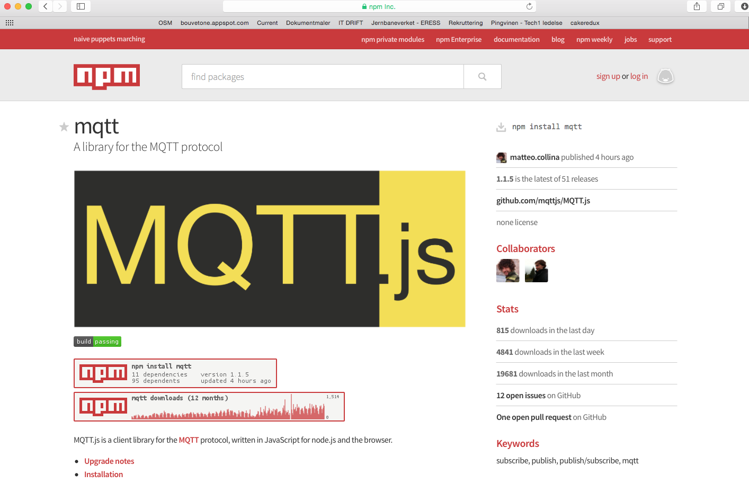

Slide 30
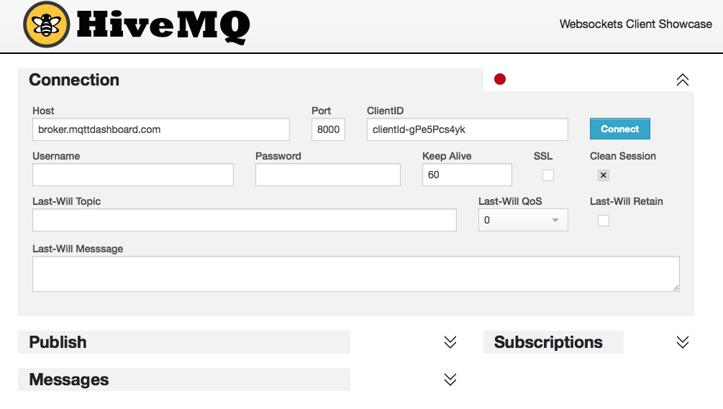

response
queue
4. Subscribe
3. Publish
MQTT Web Client
Public MQTT Broker
(Pub/Sub messaging)
Johnny-Five & Arduino
1. Publish
command
queue
2. Subscribe
Notes:
Our goal is to send messages to our arduino rig via a public MQTT broker. We will send messages from an online MQTT Web Client.
This slide shows the message flow.

